Slide 1

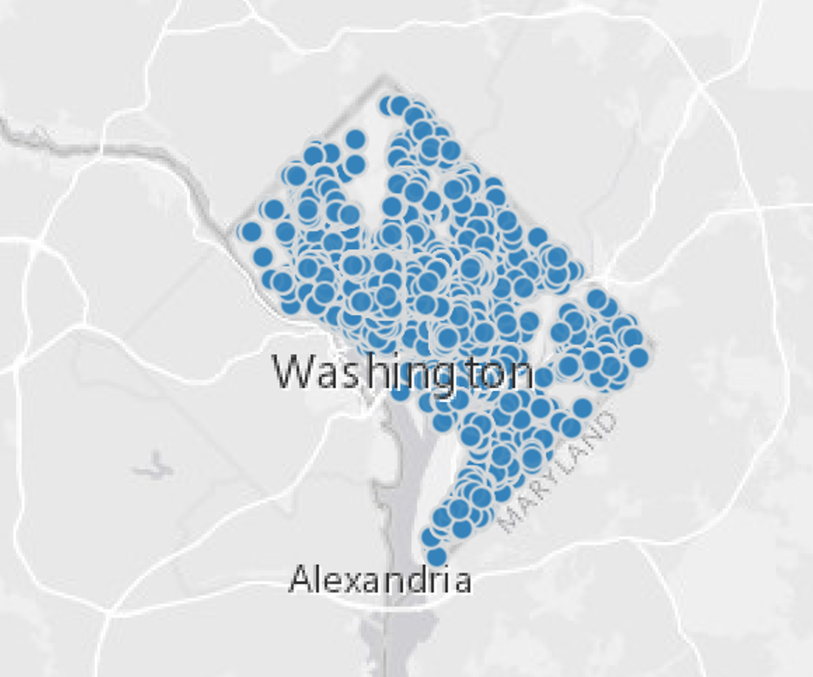
Development of Building Specific Metamodels using Washington, DC Benchmarking Data to Infer Interval Data
Nicholas Long
CVEN5830 – Grid Connected Systems
April 28, 2020

Slide 2
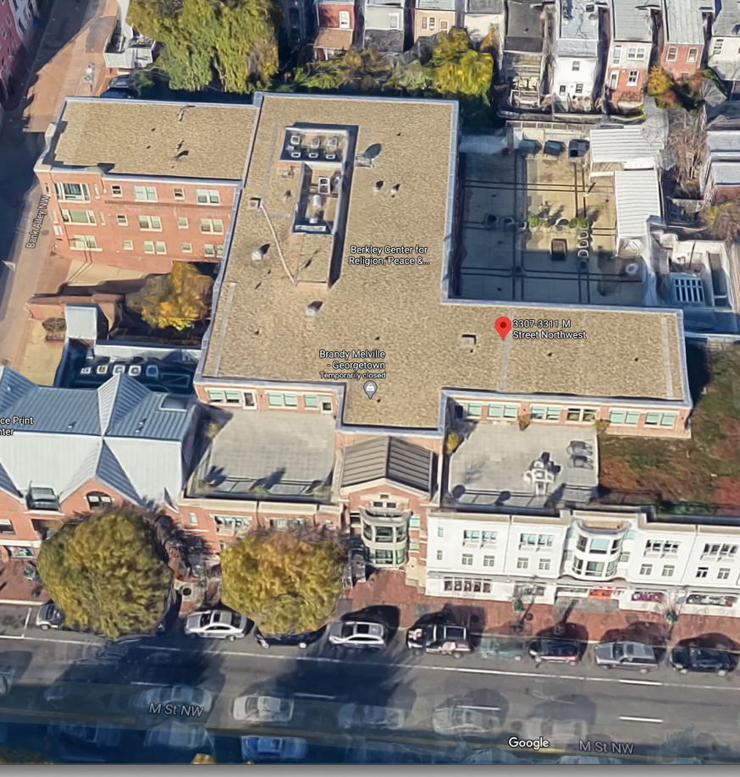
Research Question
How can high-level building benchmarking data be used to generate realistic annual load profiles of buildings?
Outline
Disclosure Data Analysis
Building Energy Modeling Results
Metamodeling
Calibration and load aggregation

Slide 3




Analysis Workflow
Inspect Disclosure Data
Parametric Analysis of BEM
Create Metamodels
Extract n Candidates
Post Process BEM
Cross-validate Metamodels
Covariate ranges
BEM Results
Building Parameters
Calibrate Model
Model Definition
Aggregate Loads
Model Definition
Model Definition

Slide 4
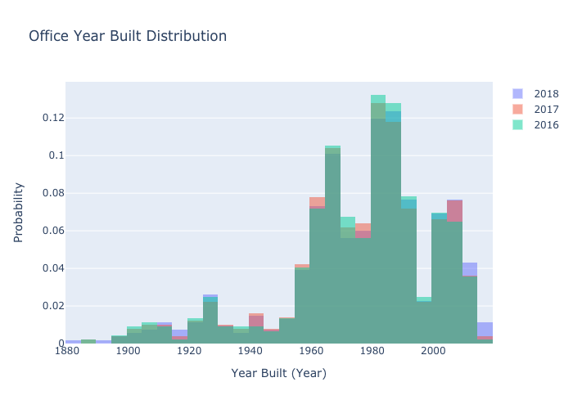
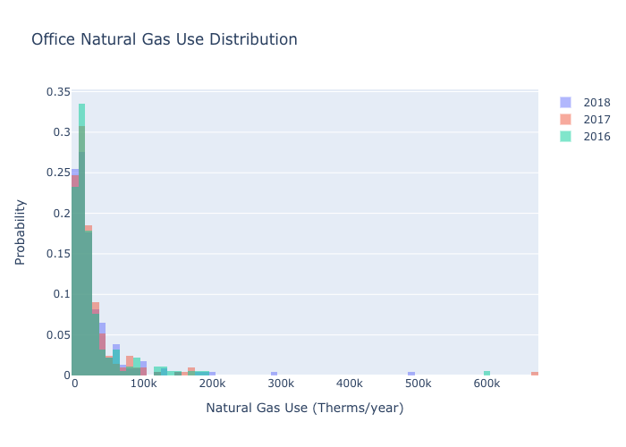
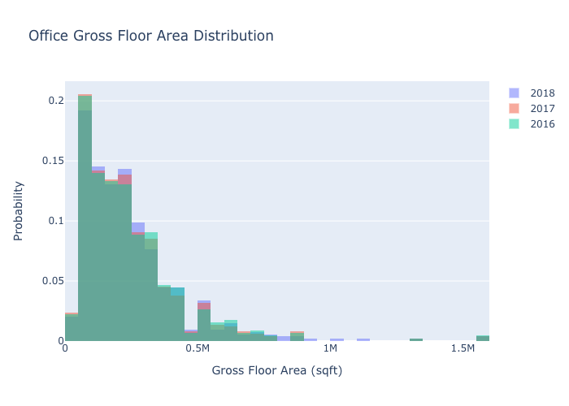
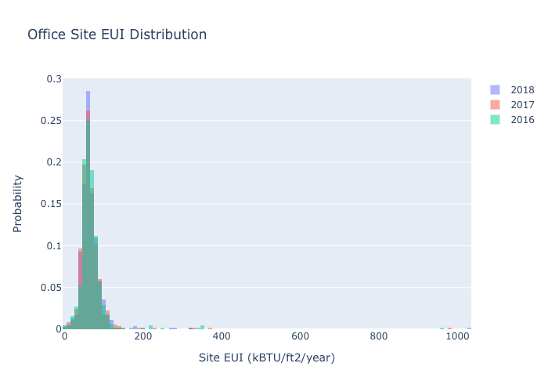
Disclosure Data Analysis
2018 had 1,798 disclose properties
54 Building types
Input | B0 | B1 | B2
Address | 1146 19th Street | 3307 - 3311 M ST NW | 1235 W Street NE
Floor Area (ft²) | 47083 | 54560 | 38964
Year Built | 1986 | 1991 | 1993
Site EUI (kBtu/ft²/year) | 59 | 84.1 | 43.9
Electricity Use (kWh) | 814,091 | 1,344,206 | 323,703
Natural Gas Use (Therms) | 0 | 0 | 6042.4

Slide 5
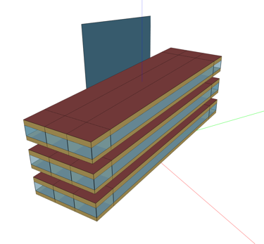
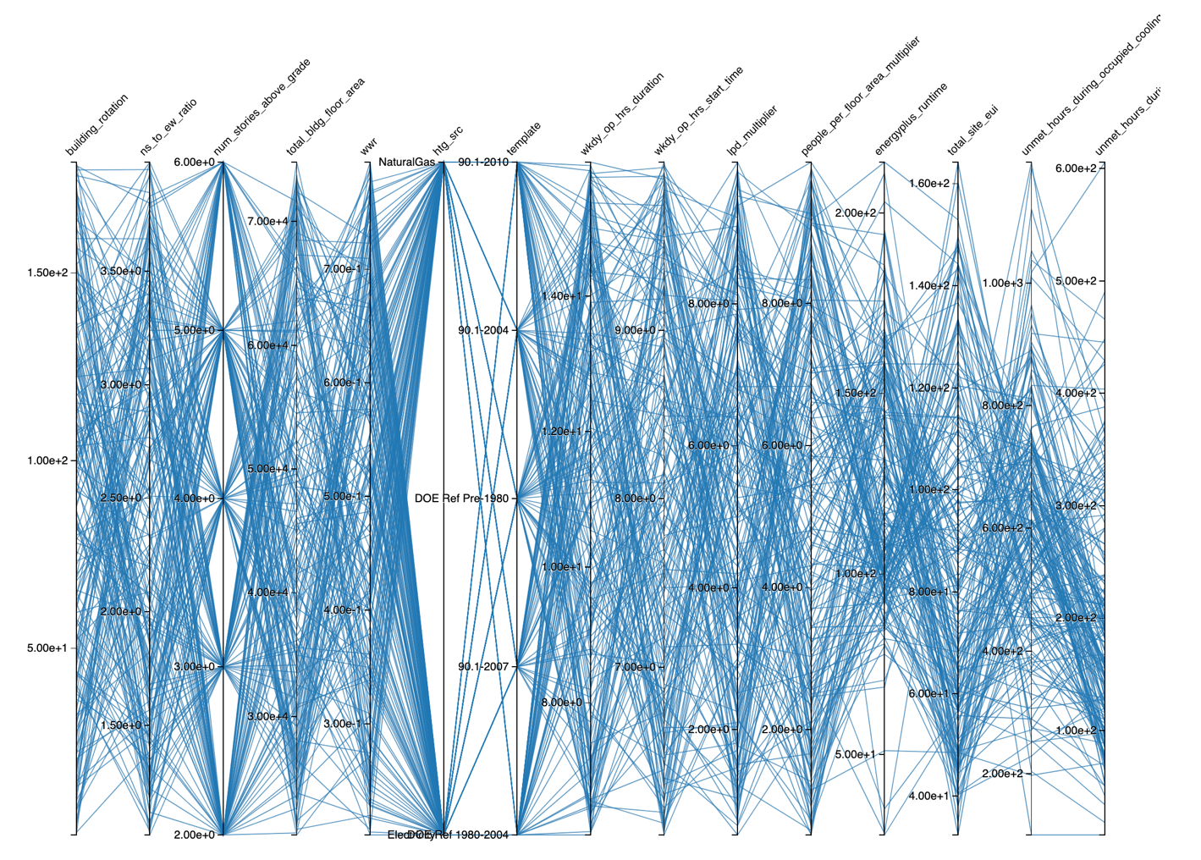
BEM Parametric Analysis
Measure Name | Variable Name | Type | Value
Building from Building Type Ratios | Primary Building Type | Static | MediumOffice
 | Floor Area | Continuous (Uniform) | [20,000, 75,000]ft²
 | Number of Stories | Discrete (Uniform) | [2, 3, 4, 5, 6]
 | Building Rotation | Continuous (Uniform) | [0, 180]°
 | Aspect Ratio | Continuous (Uniform) | [1, 4]
 | Window to Wall Ratio | Continuous (Uniform) | [0.2, 0.8]
Change Building Location | Weather File Name | Static | USA_VA_Arlington-Ronald.Reagan.Washington.Natl.AP.724050_TMY3.epw
Typical DOE Building | Target Standard | Discrete (Uniform) | [Pre-1980, 1980-2004, 90.1-2004, 90.1-2008, 90.1-2010]
 | Heating Source | Discrete (Uniform) | [Electricity, NaturalGas]
 | Hours of Operation Start Time | Continuous (Uniform) | [6,10]
 | Hours of Operation Duration | Continuous (Uniform) | [6,16]
Internal Loads | LPD Multiplier | Continuous (Uniform) | [0.5, 10]
 | People Multiplier | Continuous (Uniform) | [0.5, 10]
300 Samples
3-4 minutes per simulation

Slide 6
Metamodels
Source: https://xkcd.com/2048/

Slide 7
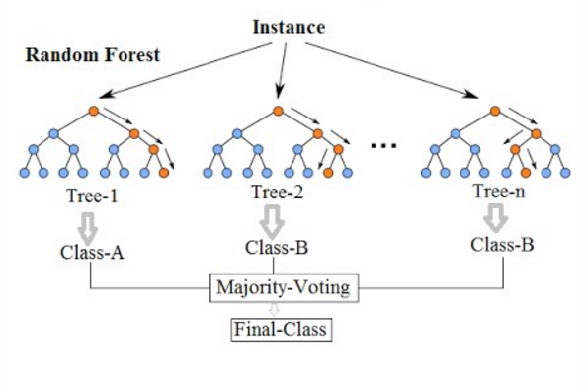
Random Forest
Ensemble method using multiple decision trees
Parameters (of interest) include:
Max depth, max features, min samples/leaf, min samples/split, and number of estimators
If classification then majority voting. If regression then average of all trees
Source: https://cdn-images-1.medium.com/max/1600/1*i0o8mjFfCn-uD79-F1Cqkw.png

Slide 8
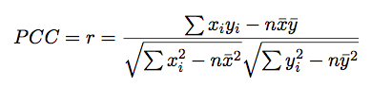
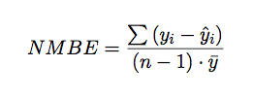
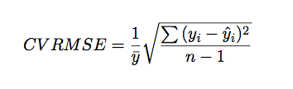
Training Methodology
All Samples
A downsampling variable was used to prevent overfitting of the data. Value was set to 5%
Training Dataset
Test Dataset
Withheld 8760-Contiguous Validation Dataset
Model performance used PCC on test dataset
Validation dataset evaluated using NMBE and CVRMSE

Slide 9
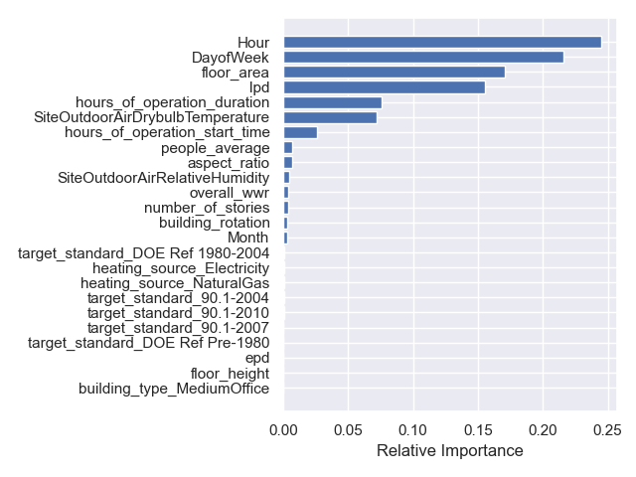
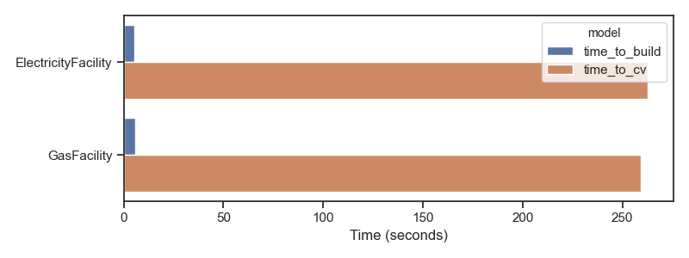
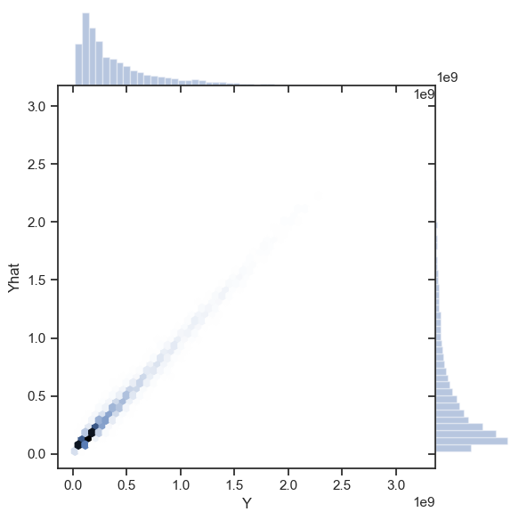
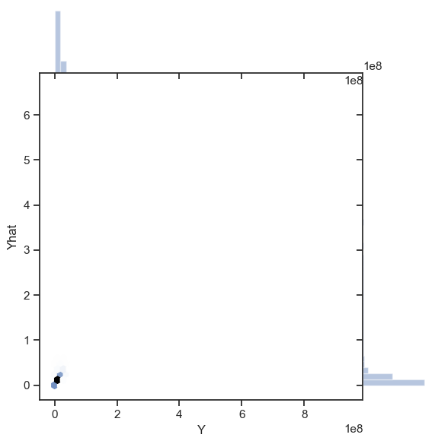
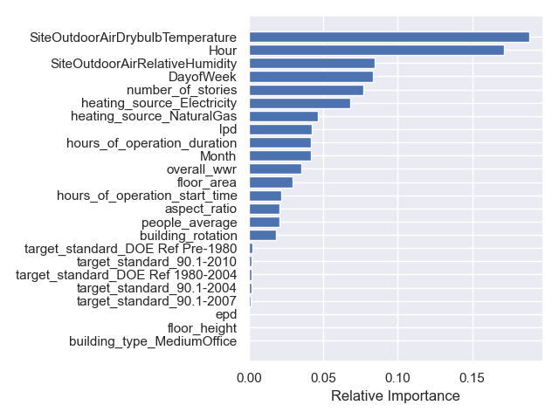
Random Forest Fitting with Cross Validation
Electricity Consumption
Gas Consumption
Electricity consumption
Gas consumption

Slide 10
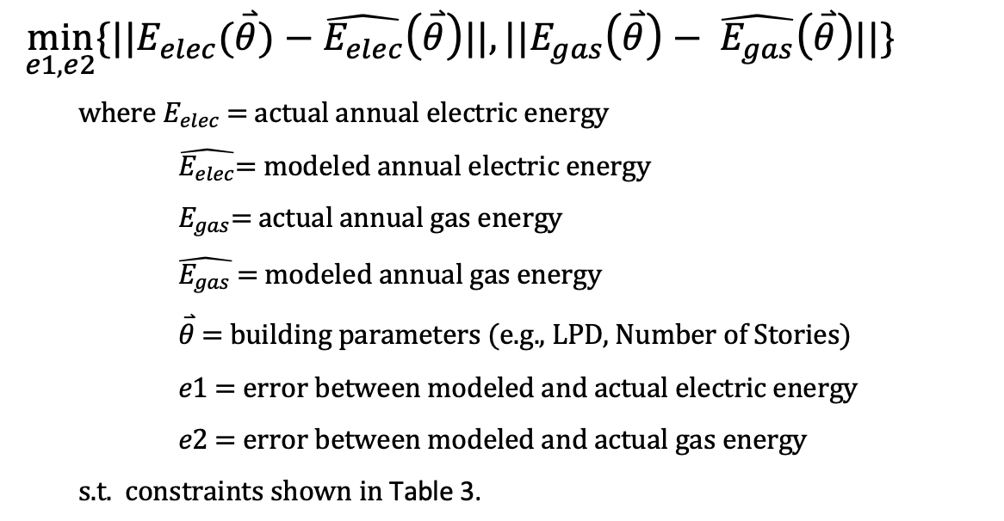
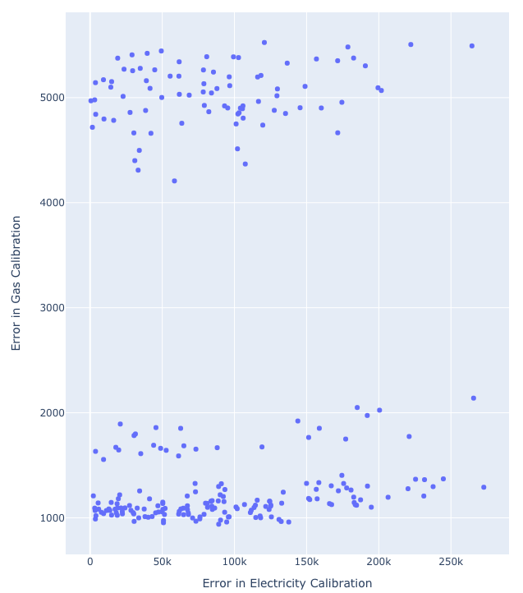
Calibration Formulation
NSGAII, Population=250, 50 max iterations
Table 3. Optimization constraints
Variable | Data Type | Range
Lighting Power Density | Real | [1, 20]
Number of Stories | Integer | [1, 13]
Aspect Ratio | Real | [1, 5]
Hours Start | Real | [6, 10]
Hours Duration | Float | [8, 16]
Heating Source | Categorical | [Electricity, NaturalGas]

Slide 11
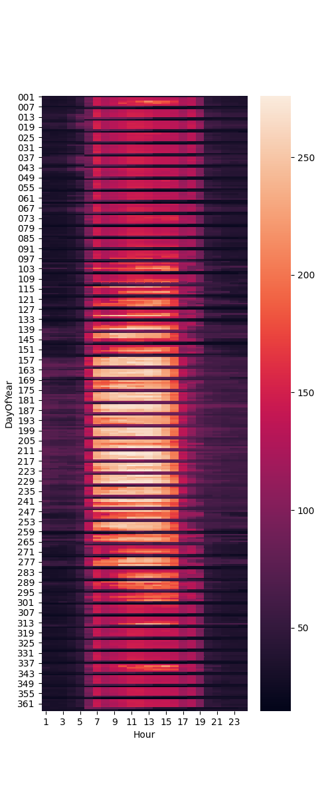
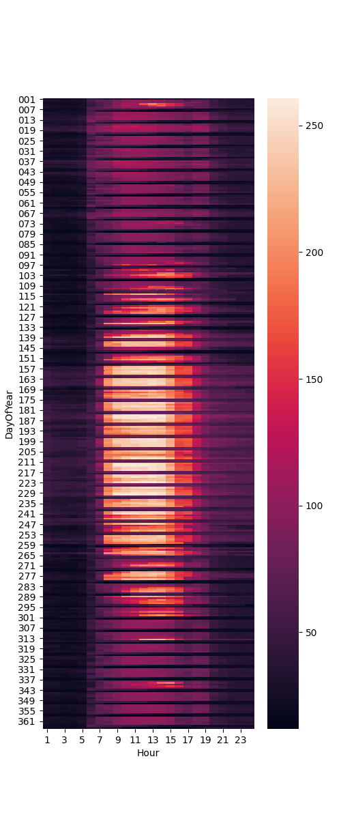
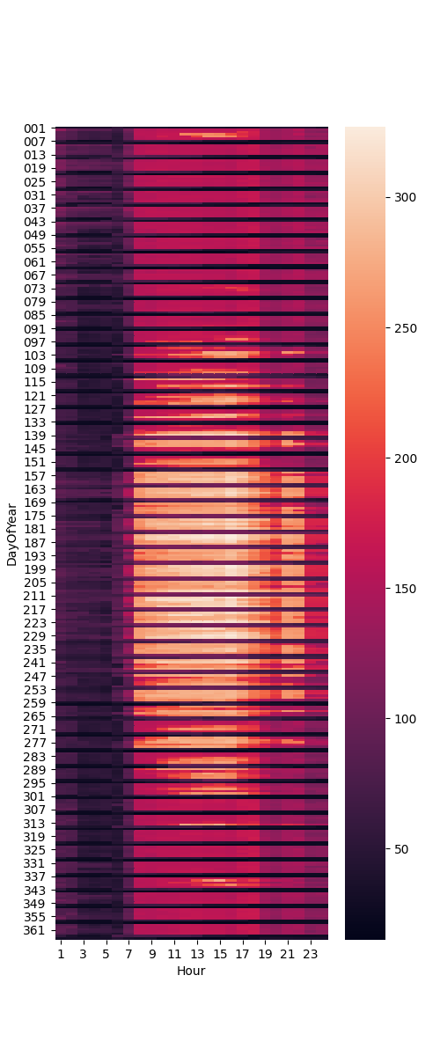
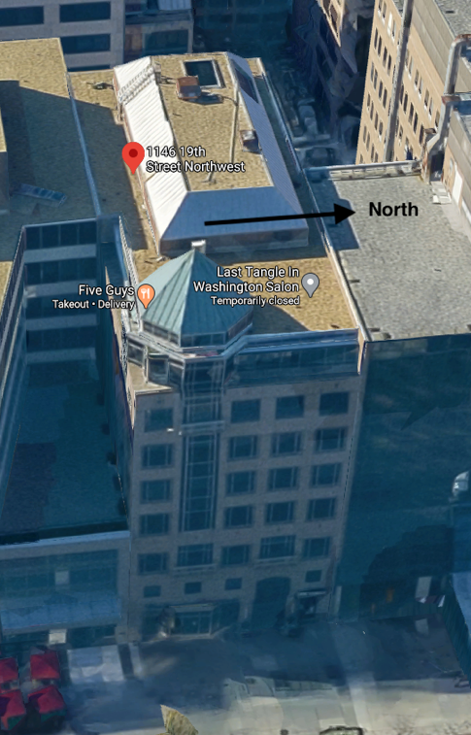
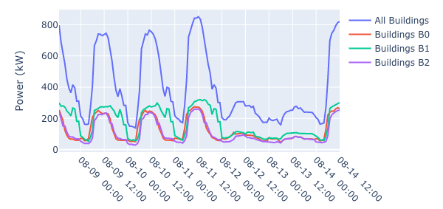
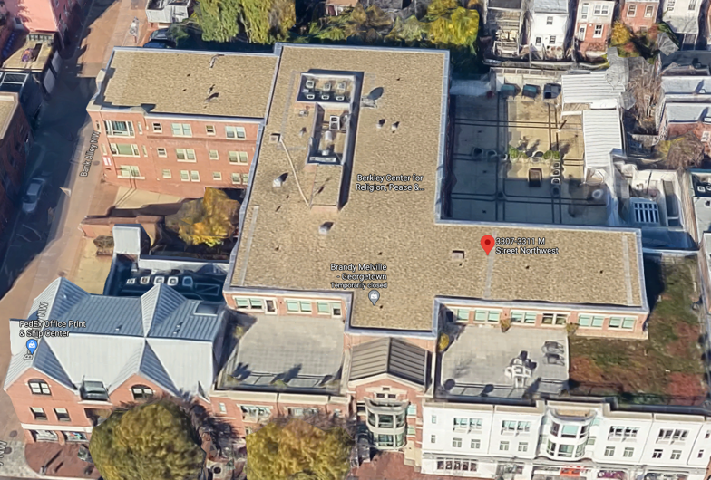
Calibration Results and Load Aggregation
Input | B0 | B1 | B2
Floor Area (ft²) | 47083 | 54560 | 38964
Number of Stories | 4 | 6 | 11
Aspect Ratio | 1.4 | 4.9 | 3.5
Hours Start | 6 | 9:45 | 9:30
Hours Duration | 9 | 14 | 8:45
Lighting Power Density (W/ft²) | 16 | 19 | 1.4
Heating Source | Electricity | Electricity | NaturalGas
Peak Weak
Building 0
Building 1

Slide 12
Thank you!
Questions?
Nicholas.L.Long@Colorado.edu

